Slide 1
Understanding The Bible
The Purpose of the Bible
The Land of the Bible
The Story of the Bible – Old Testament
The Story of the Bible – New Testament
The Year of Popularity
The Message of the Bible
The Authority of the Bible
The Interpretation of the Bible
The Use of the Bible
__________________________________________________________________________________________________________________________________
ALL WORD NOTES AND POWERPOINT PRESENTATIONS ARE AVAILABLE AT www.BethlehemChristian.org/bible

Slide 2
The Passover of the Jews was at hand, and Jesus went up to Jerusalem. (John 2:13 ESV)
Now the Passover, the feast of the Jews, was at hand. (John 6:4 ESV)
Now before the Feast of the Passover, when Jesus knew that his hour had come to depart out of this world to the Father, having loved his own who were in the world, he loved them to the end. (John 13:1 ESV)
After this there was a feast of the Jews, and Jesus went up to Jerusalem. (John 5:1 ESV)

Slide 3
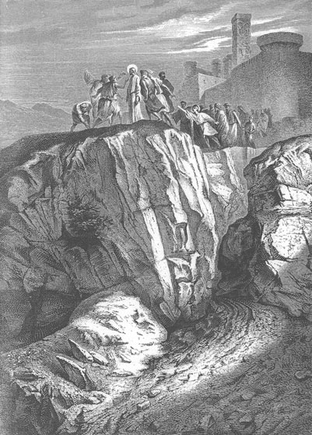

Slide 4
And he went throughout all Galilee, teaching in their synagogues and proclaiming the gospel of the kingdom and healing every disease and every affliction among the people. (Matthew 4:23 ESV)
Now after John was arrested, Jesus came into Galilee, proclaiming the gospel of God, and saying, "The time is fulfilled, and the kingdom of God is at hand; repent and believe in the gospel." (Mark 1:14, 15 ESV)

Slide 5
And when Jesus finished these sayings, the crowds were astonished at his teaching, for he was teaching them as one who had authority, and not as their scribes. (Matthew 7:28, 29 ESV)
Not like the prophets, who claimed to be speaking God’s words, not their own, for example:
Now the word of the LORD came to me, saying, (Jeremiah 1:4 ESV)
You have heard that it was said to those of old …
But I say to you that … (Matthew 5:20a, 21a ESV)
This same contrast occurs five more times in the rest of Matthew Chapter 5.

Slide 6
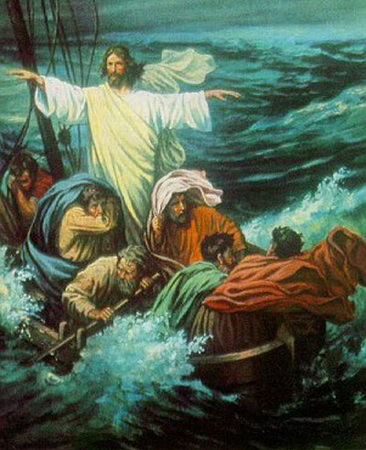

Slide 7
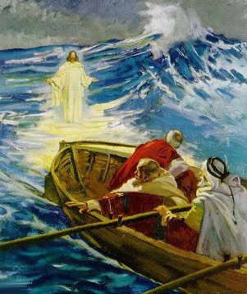

Slide 8
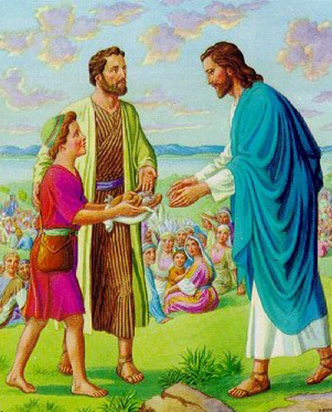

Slide 9
And he answered them, "Go and tell John what you have seen and heard: the blind receive their sight, the lame walk, lepers are cleansed, and the deaf hear, the dead are raised up, the poor have good news preached to them. (Luke 7:22 ESV)

Slide 10
But if it is by the finger of God that I cast out demons, then the kingdom of God has come upon you. (Luke 11:20 ESV)

Slide 11
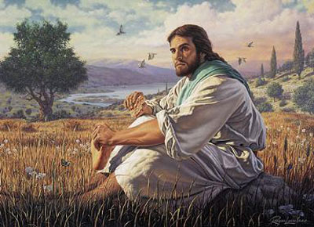

Slide 12
I am the bread of life. (John 6:48 ESV)

Slide 13
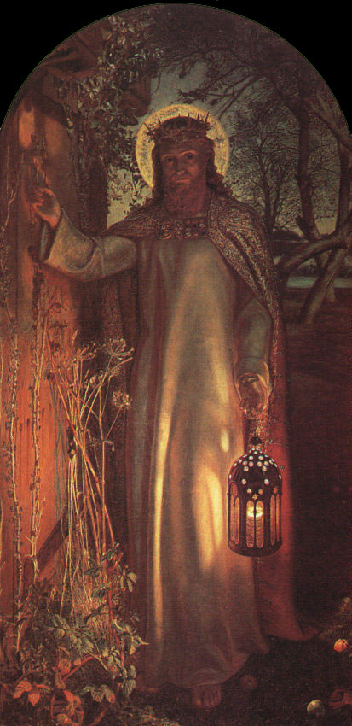

Slide 14
Again Jesus spoke to them, saying, "I am the light of the world. Whoever follows me will not walk in darkness, but will have the light of life." (John 8:12 ESV)

Slide 15
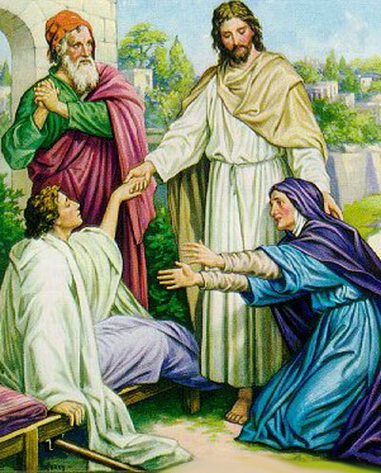

Slide 16
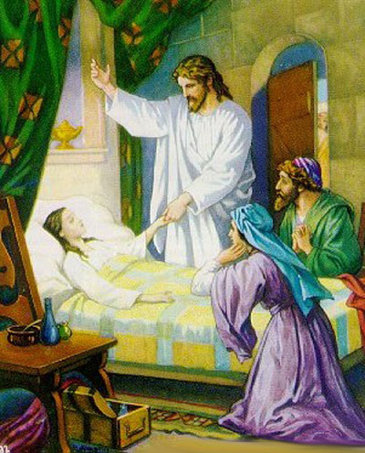

Slide 17
Jesus said to her, "I am the resurrection and the life. (John 11:25a ESV)

Slide 18
And he appointed twelve (whom he also named apostles) so that they might be with him and he might send them out to preach and have authority to cast out demons. (Mark 3:14 ESV)
And he called the twelve and began to send them out two by two, and gave them authority over the unclean spirits. (Mark 6:7 ESV)

Slide 19
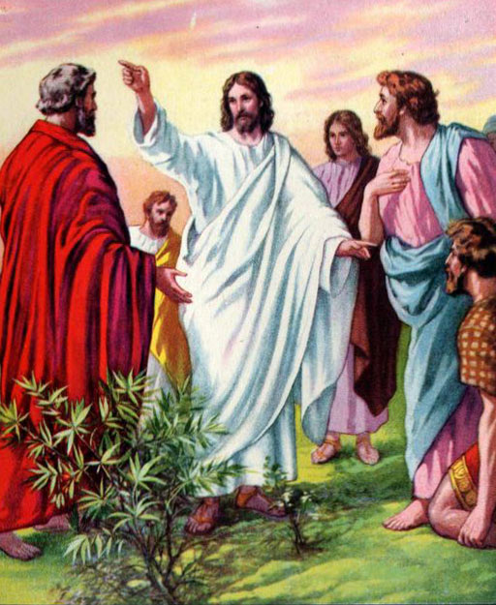

Slide 20
But now even more the report about him went abroad, and great crowds gathered to hear him and to be healed of their infirmities. (Luke 5:15 ESV)
When the people saw the sign that he had done, they said, "This is indeed the Prophet who is to come into the world!" Perceiving then that they were about to come and take him by force to make him king, Jesus withdrew again to the mountain by himself. (John 6:14, 15 ESV)

Slide 21
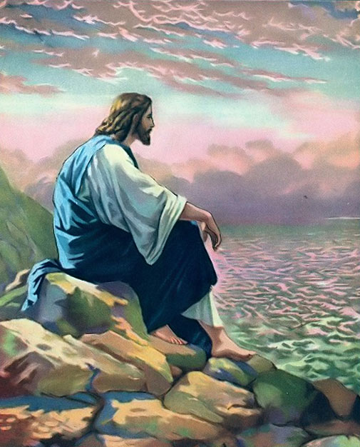

Slide 22
Jesus answered them, "Truly, truly, I say to you, you are seeking me, not because you saw signs, but because you ate your fill of the loaves. (John 6:26 ESV)

Slide 23
Understanding The Bible
The Purpose of the Bible
The Land of the Bible
The Story of the Bible – Old Testament
The Story of the Bible – New Testament
The Year of Popularity
The Message of the Bible
The Authority of the Bible
The Interpretation of the Bible
The Use of the Bible
__________________________________________________________________________________________________________________________________
ALL WORD NOTES AND POWERPOINT PRESENTATIONS ARE AVAILABLE AT www.BethlehemChristian.org/bible

